Slide 1
USE OF TRIANGLES
& CONGRUENT TRIANGLES
NCSCOS: 2.02; 2.03

Slide 2
E.Q: How do we prove triangles are congruent?
U.E.Q:
How do we prove the congruence of triangles, and how do we use the congruence of triangles solving real-life problems?

Slide 3
Geometry Then and Now
The triangle is the first geometric shape you will study. The use of this shape has a long history. The triangle played a practical role in the lives of ancient Egyptians and Chinese as an aid to surveying land. The shape of a triangle also played an important role in triangles to represent art forms. Native Americans often used inverted triangles to represent the torso of human beings in paintings or carvings. Many Native Americans rock carving called petroglyphs. Today, triangles are frequently used in architecture.

Slide 4
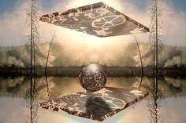
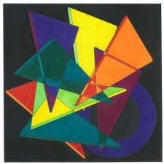

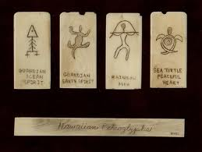
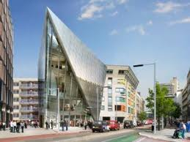
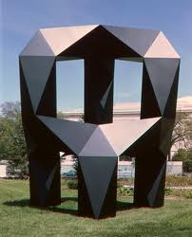

Slide 5
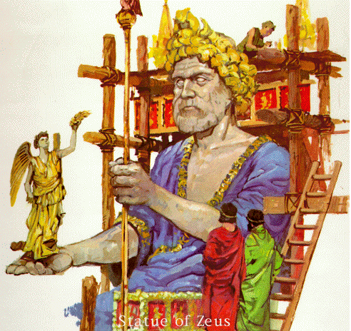
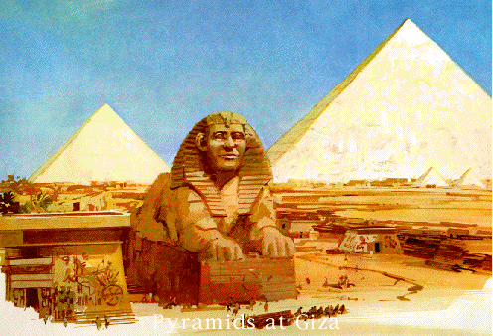
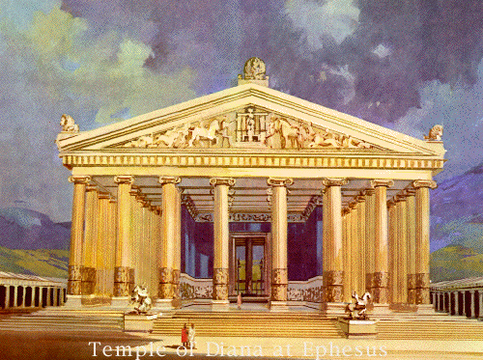
Pyramids of Giza
Statue of Zeus
Temple of Diana at Ephesus

Slide 6
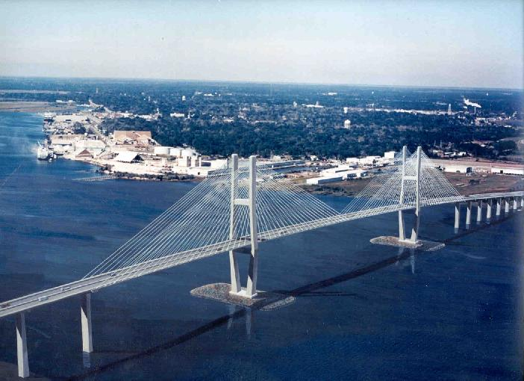
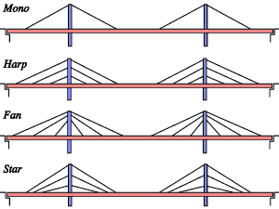
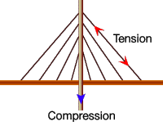
Congruent Triangles
On a cable stayed bridge the cables attached to each tower transfer the weight of the roadway to the tower.
You can see from the smaller diagram that the cables balance the weight of the roadway on both sides of each tower.
What do you notice about the triangles on opposite sides of the towers?
Why is that so important?

Slide 7
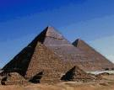

Slide 8


Slide 9
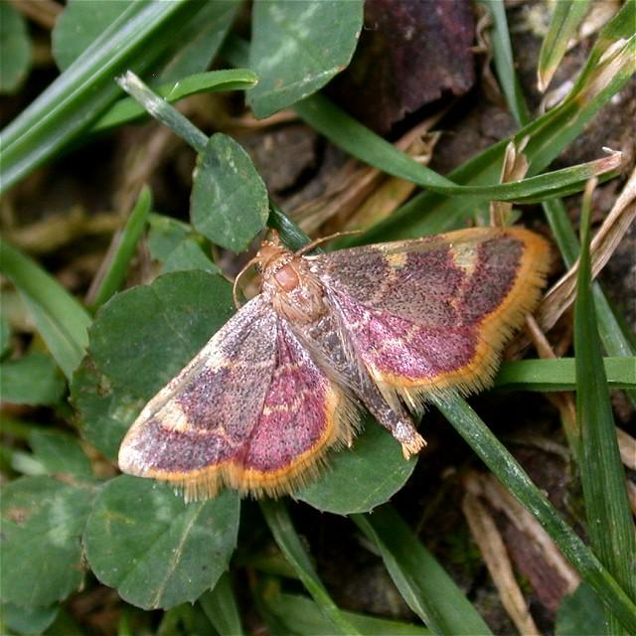
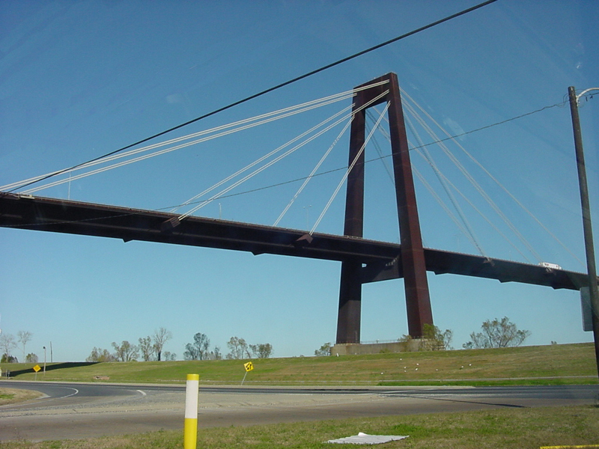
Triangles in our surroundings
We can find triangles everywhere:
In nature | In man-made structures
Replay
Slide

Slide 10
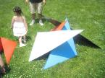

Slide 11
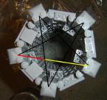

Slide 12


Slide 13
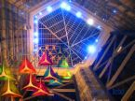

Slide 14


Slide 15


Slide 16


Slide 17
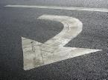

Slide 18
4.1 Triangles and Angles
Classifying Triangles

Slide 19
Triangle Classification by Sides
Equilateral
3 congruent sides
Isosceles
At least 2 congruent sides
Scalene
No congruent sides

Slide 20
Triangle Classification by Angles
Equilangular
3 congruent angles
Acute
3 acute angles
Obtuse
1 obtuse angle
Right
1 right angle

Slide 21
Vocabulary
Vertex: the point where two sides of a triangle meet
Adjacent Sides: two sides of a triangle sharing a common vertex
Hypotenuse: side of the triangle across from the right angle
Legs: sides of the right triangle that form the right angle
Base: the non-congruent sides of an isosceles triangle

Slide 22
Labeling Exercise
Label the following on the right triangle:
Vertices
Hypotenuse
Legs
Vertex
Hypotenuse
Leg
Vertex
Vertex
Leg

Slide 23
Labeling Exercise
Label the following on the isosceles triangle:
Base
Congruent adjacent sides
Legs
m<1 = m<A + m<B
Adjacent side
Adjacent Side
Leg
Leg
Base

Slide 24
More Definitions
Interior Angles: angles inside the triangle
(angles A, B, and C)
2
B
Exterior Angles: angles adjacent to the interior angles
(angles 1, 2, and 3)
1
A
C
3

Slide 25
Triangle Sum Theorem (4.1)
The sum of the measures of the interior angles of a triangle is 180º.
B
A
C
<A + <B + <C = 180º

Slide 26
Exterior Angles Theorem (4.2)
The measure of an exterior angle of a triangle is equal to the sum of the measures of two nonadjacent interior angles.
B
A
1
m<1 = m <A + m <B

Slide 27
The acute angles of a right triangle are complementary.
B
A
m<A + m<B = 90º

Slide 28
4.2 Congruence and Triangles
NCSCOS: 2.02; 2.03

Slide 29
Congruent Figures
(
B
A
___
2 figures are congruent if they have the exact same size and shape.
When 2 figures are congruent the corresponding parts are congruent. (angles and sides)
Quad ABDC is congruent to Quad EFHG
___
___
___
___
___
))))
___
___
___
___
)))
((
D
C
F
(
E
___
___
___
___
___
___
))))
___
___
___
___
)))
H
((
G

Slide 30
∠Z
If Δ ABC is ≅ to Δ XYZ, which angle is ≅ to ∠C?

Slide 31
Thm 4.3 3rd angles thm
If two ∠s of one Δ are ≅ to two ∠s of another Δ, then the 3rd ∠s are also ≅.

Slide 32
Given: seg RP ≅ seg MN, seg PQ ≅ seg NQ , seg RQ ≅ seg MQ, m∠P=92º and m∠N is 92º. Prove: ΔRQP ≅ ΔMQN
N
R
92º
Q
92º
P
M

Slide 33
Corresponding Parts
In Lesson 4.2, you learned that if all six pairs of corresponding parts (sides and angles) are congruent, then the triangles are congruent.
AB ≅ DE
BC ≅ EF
AC ≅ DF
∠ A ≅ ∠ D
∠ B ≅ ∠ E
∠ C ≅ ∠ F
B
A
C
ΔABC ≅ Δ DEF
E
F
D

Slide 34
SSS
If all the sides of one triangle are congruent to all of the sides of a second triangle, then the triangles are congruent. (SSS)

Slide 35
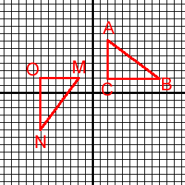

Example #1 – SSS – Postulate
Use the SSS Postulate/rule to prove the two triangles are congruent. Find the length of each side.

Slide 36
Definition – Included Angle
K is the angle between JK and KL. It is called the included angle of sides JK and KL.
What is the included angle for sides KL and JL?
L

Slide 37
SAS – Postulate/Rule
If two sides and the included angle of one triangle are congruent to two sides and the included angle of a second triangle, then the triangles are congruent. (SAS)
S
A
S
A
S
S
by SAS

Slide 38
Example #2 – SAS – Postulate
Given: N is the midpoint of LW N is the midpoint of SK
Prove:
N is the midpoint of LW N is the midpoint of SK
Given
Definition of Midpoint
Vertical Angles are congruent
SAS Postulate

Slide 39
Definition – Included Side
JK is the side between J and K. It is called the included side of angles J and K.
What is the included side for angles K and L?
KL

Slide 40
ASA - Postulate
If two angles and the included side of one triangle are congruent to two angles and the included side of a second triangle, then the triangles are congruent. (ASA)
by ASA

Slide 41
Example #3 – ASA – Postulate
Given: HA || KS
Prove:
HA || KS,
Given
Alt. Int. Angles are congruent
Vertical Angles are congruent
ASA Postulate

Slide 42
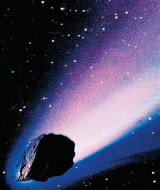
METEORITES
When a meteoroid (a piece of rocky or metallic matter from space) enters Earth’s atmosphere, it heatsup, leaving a trail of burning gases called a meteor. Meteoroid fragments that reach Earth without burningup are called meteorites.

Slide 43
On December 9, 1997, an extremely bright meteor lit up the sky
above Greenland. Scientists attempted to find meteorite fragments by collecting data from eyewitnesses who had seen the meteor pass through the sky. As shown, the scientists were able to describe sightlines from observers in different towns. One sightline was from observers in Paamiut (Town P) and another was from observers in Narsarsuaq (Town N). Assuming the sightlines were accurate, did the scientists have enough information to locate any meteorite fragments? Explain. ( this example is taken from your text book pg. 222

Slide 44
Identify the Congruent Triangles.
Identify the congruent triangles (if any). State the postulate by which the triangles are congruent.
by SSS
Note: is not SSS, SAS, or ASA.
by SAS

Slide 45
Example #4 – Paragraph Proof
Given:
Prove:
is isosceles with vertex bisected by AH.
Sides MA and AT are congruent by the definition of an isosceles triangle.
Angle MAH is congruent to angle TAH by the definition of an angle bisector.
Side AH is congruent to side AH by the reflexive property.
Triangle MAH is congruent to triangle TAH by SAS.
Side MH is congruent to side HT by CPCTC.

Slide 46
Example #5 – Column Proof
Given:
Prove:
has midpoint N
Given
A line to one of two || lines is to the other line.
Perpendicular lines intersect at 4 right angles.
Substitution, Def of Congruent Angles
Definition of Midpoint
SAS
CPCTC

Slide 47
Summary
Triangles may be proved congruent by Side – Side – Side (SSS) Postulate Side – Angle – Side (SAS) Postulate, and Angle – Side – Angle (ASA) Postulate.
Parts of triangles may be shown to be congruent by Congruent Parts of Congruent Triangles are Congruent (CPCTC).

Slide 48
Angle-Angle-Side Theorem
If two angles and a non included side of one triangle are congruent to two angles and non included side of a second triangle, then the two triangles are congruent.

Slide 49
Prove this theorem in group by two and share.

Slide 50
Do you need all six ?
NO !
SSS
SAS
ASA
AAS

Slide 51
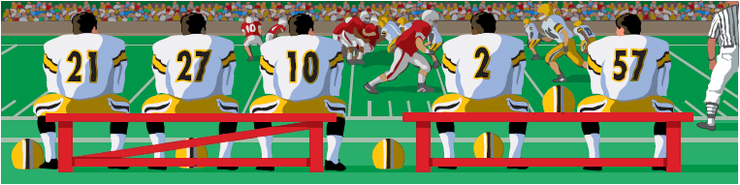
Solve a real-world problem
Structural Support
Explain why the bench with the diagonal support is stable, while the one without the support can collapse.

Slide 52
Solve a real-world problem
SOLUTION
The bench with a diagonal support forms triangles with fixed side lengths. By the SSS Congruence Postulate, these triangles cannot change shape, so the bench is stable. The bench without a diagonal support is not stable because there are many possible quadrilaterals with the given side lengths.

Slide 53
Warning: No SSA Postulate
There is no such thing as an SSA postulate!
B
E
F
A
C
D
NOT CONGRUENT

Slide 54
Warning: No AAA Postulate
There is no such thing as an AAA postulate!
B
E
A
C
F
D
NOT CONGRUENT

Slide 55
Tell whether you can use the given information at determine whether
ABC ≅ Δ DEF
∠A ≅ ∠D, AB≅DE, AC≅DF
AB ≅ EF, BC ≅ FD, AC≅ DE

Slide 56
The Congruence Postulates & Theorem
SSS correspondence
ASA correspondence
SAS correspondence
AAS correspondence
SSA correspondence
AAA correspondence

Slide 57
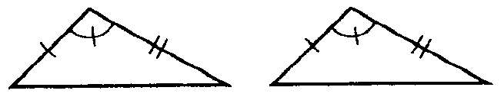
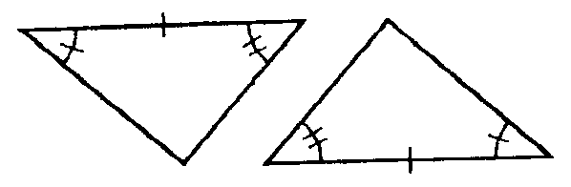
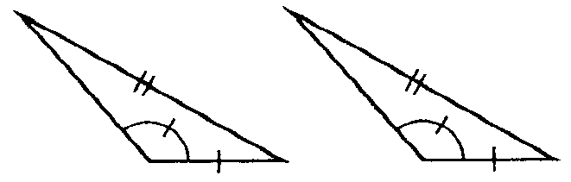
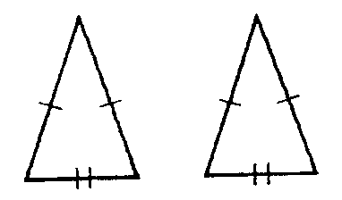
Name That Postulate
(when possible)
SAS
ASA
SSA
SSS

Slide 58
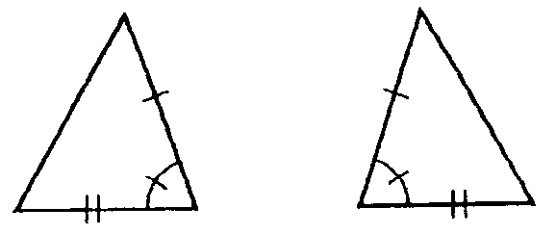
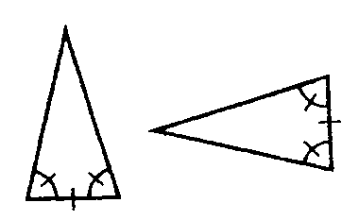
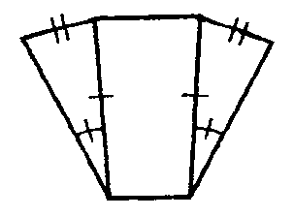
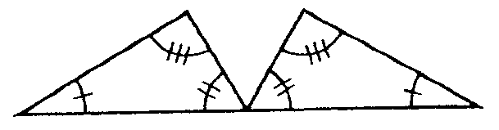
Name That Postulate
(when possible)
AAA
ASA
SAS
SSA

Slide 59
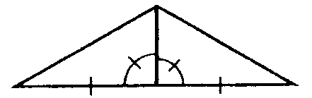
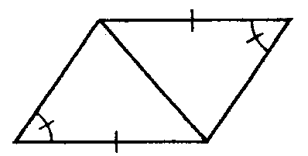
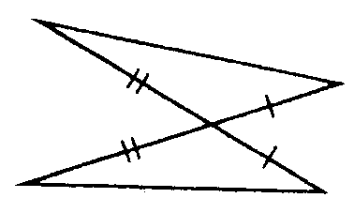
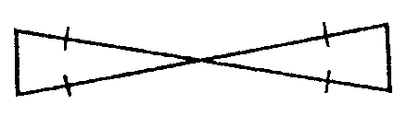
Name That Postulate
(when possible)
Vertical Angles
Reflexive Property
SAS
SAS
Vertical Angles
Reflexive Property
SAS
SSA

Slide 60
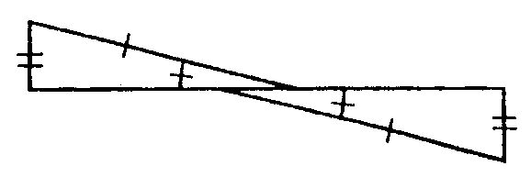
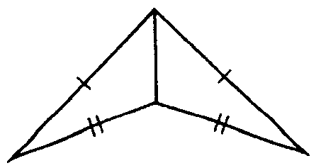
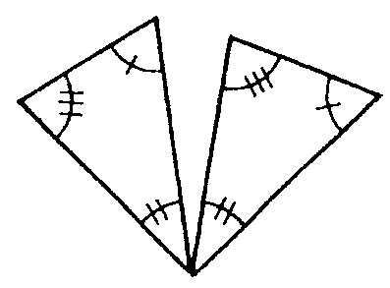
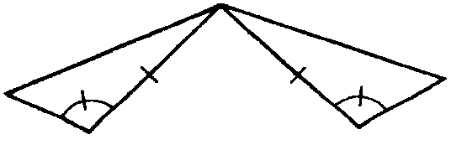
HW: Name That Postulate
(when possible)

Slide 61
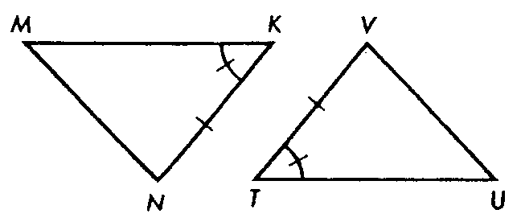
Closure
Indicate the additional information needed to enable us to apply the specified congruence postulate.
For ASA:
For SAS:
For AAS:

Slide 62
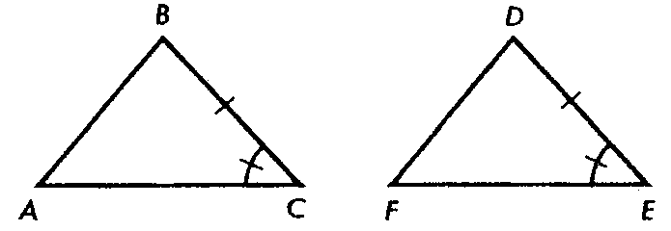
Let’s Practice
Indicate the additional information needed to enable us to apply the specified congruence postulate.
For ASA:
∠B ≅ ∠D
For SAS:
AC ≅ FE
For AAS:
∠A ≅ ∠F

Slide 63
Now For The Fun Part…
Proofs!

Slide 64
Given: JO ⊥ SH; O is the midpoint of SH Prove: Δ SOJ ≅ HOJ

Slide 65
Write a two column Proof
Given: BC bisects AD and ∠A ≅ ∠ D
Prove: AB ≅ DC
A C
E
B D

Slide 66
Isosceles, Equilateral, and Right Triangles

Slide 67
4.6 Isosceles, Equilateral, and Right Triangles
The two angles in an isosceles triangle adjacent to the base of the triangle are called base angles.
The angle opposite the base is called the vertex angle.
Vertex Angle
Base Angle
Base Angle

Slide 68
Base Angles Theorem
If two sides of a triangle are congruent, then the angles opposite them are congruent.
A
C
B

Slide 69
Converse to the Base Angles Theorem
If two angles of a triangle are congruent, then the sides opposite them are congruent.

Slide 70
Corollary to the Base Angles Theorem
If a triangle is equilateral, then it is equiangular.

Slide 71
Corollary to the Converse of the Base Angles Theorem
If a triangle is equiangular, then it is equilateral.

Slide 72
C
A
C
B
A
A
B
C
B
Yes
Yes
No

Slide 73
Hypotenuse-Leg (HL) Congruence Theorem
If the hypotenuse and a leg of a right triangle are congruent to the hypotenuse and a leg of a second right triangle, then the two triangles are congruent.
A
D
B
C
E
F

Slide 74
Practice Problems
Find the measure of the missing angles and tell which theorems you used.
B
B
A
50°
C
A
C
m B=80°
(Base Angle Theorem)
m C=50°
(Triangle Sum Theorem)
m A=60°
m B=60°
m C=60°
(Corollary to the Base Angles Theorem)

Slide 75
More Practice Problems
Is there enough information to prove the triangles are congruent?
S
T
U
R
V
No
Yes
No
W

